Slide 1
I got 99 problems, but a WAF ain’t one
By your boy, Run D.M.Z.

Slide 2
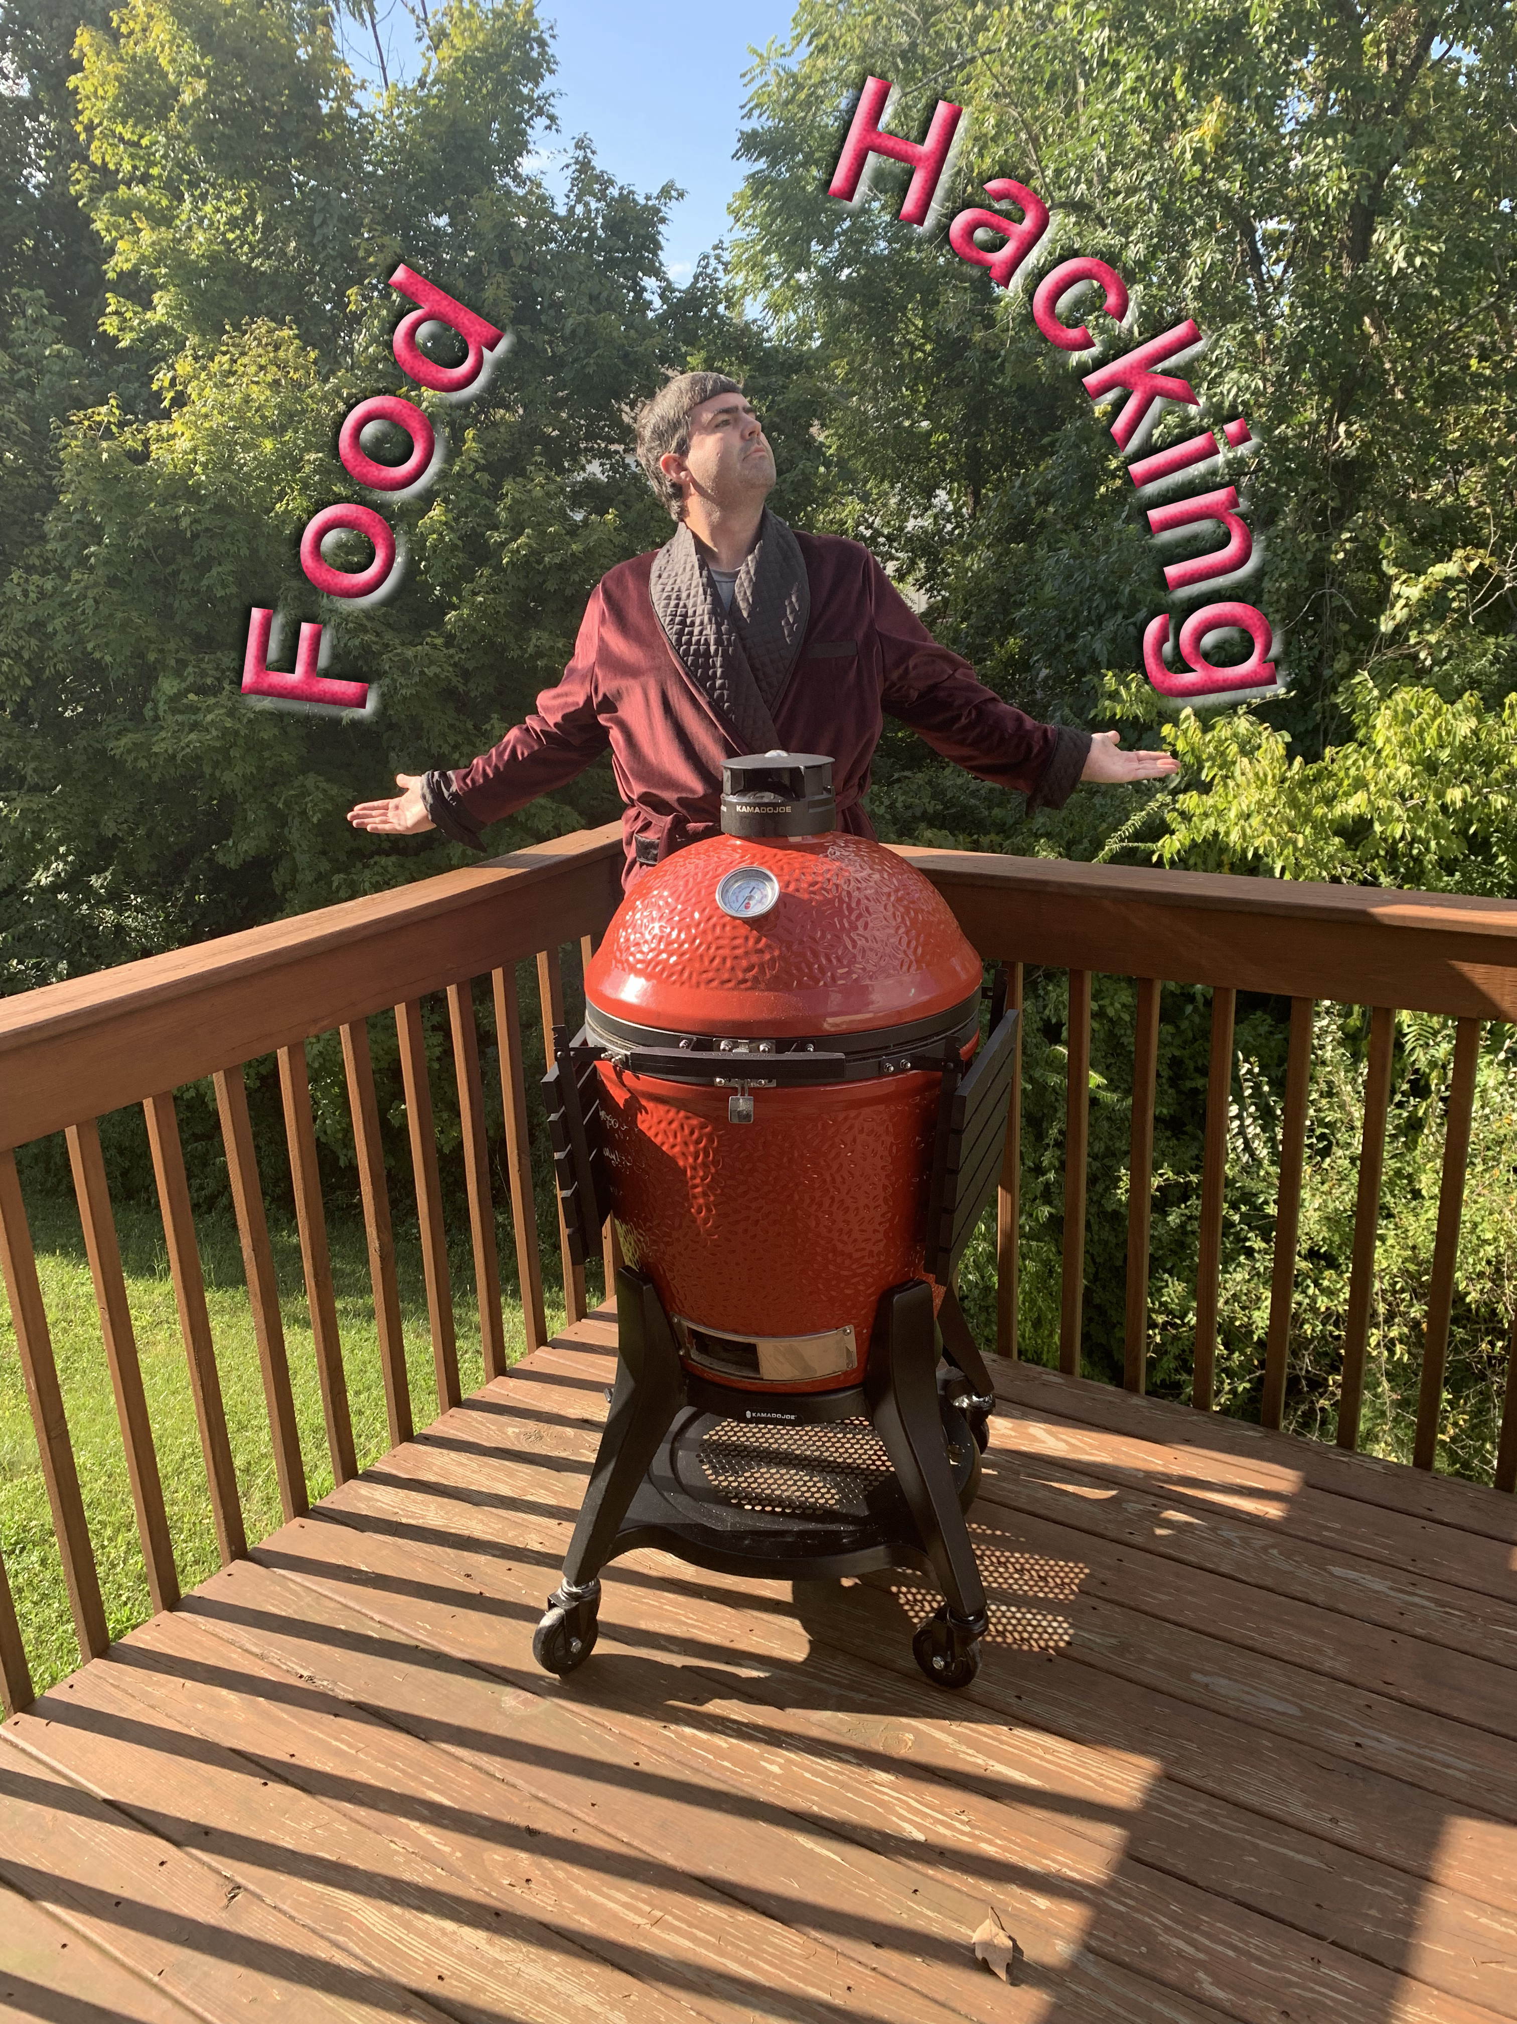
Micah K Brown
Twitter: @MicahKBrown
Munich Re: IT Security Engineer II
GitHub: https://github.com/micahkbrown
DLP Demystified
Star Wars: How an ineffective Data Governance Program Destroyed the Galactic Empire
How to cook a Five Star Meal from the Convenience of Your Hotel Room (Derby Con 2019)
Doing simple at scale
Cohost of ThreatReel.com Podcast (with @c3rkah)
Vice President of Greater Cincinnati ISSA Chapter
CISSP
Served 45 pounds of free Pulled Pork to @DerbyCon 2019!
Real Corp 2018 goal: “Learn to Cook Brisket Like a Texan.”
Real Corp 2019 goal: “Continue to Cook Brisket Like a Texan.”
On most Fridays, find me smoking both an old fashioned and pizza!
*Thoughts and view are my own and do not reflect that of my employer.
Notes:
Need to Update

Slide 3




Greater Cincinnati IT Security groups
http://www.cincy-issa.org/
https://sites.google.com/view/cincysmba
https://www.meetup.com/TechLife-Cincinnati/events/
https://www.infoseccincy.org/

Slide 4
What is a WAF:
“This, is the WORST project I ever worked on”
― Micah K Brown

Slide 5

What is a WAF
A web application firewall (WAF) is a specific form of application firewall that filters, monitors, and blocks HTTP traffic to and from a web service. By inspecting HTTP traffic, it can prevent attacks exploiting a web application's known vulnerabilities, such as SQL injection, cross-site scripting (XSS), file inclusion, and improper system configuration.
https://en.wikipedia.org/wiki/Web_application_firewall

Slide 6
What is a WAF

Slide 7
Build – Tune – Support Model

Slide 8
Biggest challenges
Like most projects, success and failure depends on the team.
High Total Cost of Ownership and Management Support
Overcoming Fear, Uncertainty, Doubt!
Clearly defining post SDLC life under a WAF.
Conflicts with work already in ‘App Dev Pipeline’.
Winning trust and support from App Dev.
Not all environments are equal (feature by feature).
How can you intercept Web Traffic (DNS vs passthrough)
If use DNS, your TTL will control how fast you can move WAF out of line with traffic.

Slide 9
WAF Team, Assemble
“THIS, is the worst project I ever worked on!”
― Micah K Brown
You are going to need a bigger boat

Slide 10
Team WAF
Build
Strong Skills: networking, IT Architecture, Cloud Architecture, strongly understand organizations policies
Tune
Strong Skills: Application / Web Development Security, common AppDev vulnerabilities.
Support
Strong Skills: Networking, Customer specific WAF support, Application / Web Development Security, company policies such as hardening guides / change control / and ticketing systems, Building WAF Support Service, Training WAF support team

Slide 11
Team Application
Application Owner
Generally this will be a manager or architect of an application. This person that is responsible for uptime and availability of an application. Technical knowledge is not required, but they need to pull the correct technical people in.
Application Developer
A member of the Application Development team should be assigned to the project team. (Critical)
Testers
A member of the Application Development team should be assigned to the project team. (Critical)

Slide 12
Build Phase:
“This, IS the worst project I ever worked on!”
― Micah K Brown

Slide 13
Build Phase: Architecture
Define overall WAF Architecture
Build out and WAF support systems
Centralized Management
Logging
Licensing

Slide 14
Build Phase: Plan / Design
Work with App Owner \ App Dev to understand Application and how to integrate a WAF.
Formalize environment learning into a documented plan that defines:
Entire implementation and support strategy.
Rolls and Responsibilities.
Processes, Procedures, SLAs.
Diagrams are awesome for showing this
Gain agreement with App Owner and App Dev before building.

Slide 15
Build Phase: Cold Build
Work with IT to stand up initial build of WAF.
Apply initial Security Policy and any customizations needed for the App.
At the end of this phase Build resource can turn the WAFs over to Tune, AppDev, and Testers to test application via host file redirection ahead of planning inline. Any learning suggestions / alerts should be reviewed for tune / block decision.
Volume and Diversity of traffic is critical for testing / validation.

Slide 16
Build Phase: Put in line
Get App Owner approval that ready to go inline in learning / transparent mode based based on host file testing.
Get date, needed resources, and submit needed change control.
I found implementation via Bridge call was best.
Execute maintenance window to go in-line and validate functionality:
Transition WAF over to Tune Phase.
WAF now starts 24x7 / after ours support.

Slide 17
Tune Phase:
“This, is the worst project, I eeeeeeeeeeeeeeeeeeeeeeeeeeeeeeeeeeeeeeeeeeeeeeeeeeeeeeeeeeeeeeeeeeeeeeeeeeeeeeeeeeeeeeeeeeeeeeeeeeeeeeeeeeeeeeeeeeeeeeeeever worked on!”
― Micah K Brown

Slide 18
Tune Phase: initial tuning
When we first go in-line the WAF will be in transparent / learning mode.
Tune will meet regularly with App Dev to review every learning suggestion / alert or tune / block decisions.
Both volume and diversity of traffic are critical.
Make sure that niche functionality is also tested. (Cross function testers)
Have Testers execute tests often.
At some point you will see significant reduction to new learning suggestions / alerts. At this time start working with AppDev and App Owner on declaring success and start planning to put WAF into Blocking Mode.

Slide 19
Tune Phase: initial tuning
Get App Owner approval that ready to convert to Blocking Mode.
Get date, needed resources, and submit needed change control.
I found implementation via Bridge call was best.
Execute maintenance window to go in-line and validate functionality:
At this point the WAF should be kept in the Tune phase for a period of time to ensure no issues significant arise before handing over to the WAF Support Service.

Slide 20
Support Phase:
“This, is the worst project, I ever WORKED on!”
― Micah K Brown

Slide 21
Support Phase: Business as Normal
Day in / day out support.
Start of day, week, month procedures.
Regular review for learning suggestions and alerts. Escalate to AppDev if needed.
Move / Add / Change tickets.
Troubleshooting / performance testing procedures
Patching
Documentation
Training

Slide 22
Architecture:
“This, is the worst project, I ever worked ON!”
― Micah K Brown

Slide 23
On Prem: Considerations
Physical vs virtual machines.
How to intercept traffic (DNS vs transparent capture)
MGMT port should be on internal ‘protected’ VLAN.
Front end web-application servers sould not be internet accessible once protected by a WAF.

Slide 24
On Prem

Slide 25
Cloud: Considerations
Implement is same cloud container or different?
Implement in same environment as servers is quickest but then AppDev might have more control over the WAF than you desire.
Implement in different cloud environments how do you pass traffic (over internet, vnet peering, VPN)
How do you manage WAFs
Hardened Jump Server vs direct internet login

Slide 26
Cloud Single Container

Slide 27
Cloud: Multiple containers

Slide 28
One Policy to rule them all
Do you want to have a single policy to rule them all?
Default answer from App Dev is that they want lower level environments to mirror Production as much as possible.
Often, lower level environments are not identical. Thus, blindly copying learning suggestions / config / policy could have adverse effects.
Pay attention to cryptography (lower environments)
Do not use vendor supplied / generic wildcard
Ensure strength and cyphers
Use trusted CAs.

Slide 29
Learning suggestion could occur at any level
During the course of normal work it is expected that Test, Stage, and Production could have different revisions of ‘the policy’ based off the traffic observed and learning suggestions created by the AI / ML:
Production would represent the ‘now’ state of production.
Stage would represent the ‘near future’ state of production.
Test would represent the ‘future future’ state of production.
We need to create process and procedures to allow (and encourage) learning suggestions flowing ‘bottom up’, ‘top down’, and ‘middle out’ as shown directly to the left of this sentence that you are reading currently. This brings up other questions including, but not limited to:

Slide 30
Policy Push Questions
What is the trigger to invoke policy push? (time vs event) Critical push should happen as soon as change control / maintenance window allows? Batch process for medium to low block? All blocks matter and should be treated with post haste?
When demoting policy from higher environment to lower environment how to we ensure that learning suggestions unique to that environment are retained? (Prior to demote do we push from the lower environment to the higher environment, then push the newly updated higher environment to the lower environment?)
Can you promote / demote single Learning Suggestion vs entire policy?
I have heard talk about forking policies to be specific per web application. (So each WAF in we would have one parent policy and 5 / 6 child policies. How would this effect promote / demote activities? If we promote a policy from test to stage are we at risk for resetting the learning database on other policies?)
How do we track this for our own sake and audit?

Slide 31
Bonus: My sample go inline change documentation
“This, is THE worst project, I ever worked on!”
― Micah K Brown

Slide 32
Change to go inline 1:2
Prep – To be completed ahead of time
0.1. SEARiousMeats: set DNS TTL to (must be done 48 hours in advance)
Reduce TTL down to 90 seconds:
Plan to go inline SEARiousMeats
Date: TBD
Time: TBD
Meeting Invite: To be generated
Players:
• Build: Micah K Brown - Coach
• WAF Testers: Sally
• SEARiousMeats DNS: Tom
• SEARiousMeats Tester: Dick
• SEARiousMeats App Owner / Acceptance: Harry
FQDN (A or CName) | Original IP | TTL (sec)
https://SEARiousMeats.net | 1.1.1.1 | 90
0.2. IT Sec SSL Labs

Slide 33
Change to go inline 2:2
Implementation Window
1. Tom / SEARiousMeats: change DNS Records
4. The Web-apps from step one are relased to App Owners / App testers. (2h)
5. With one hours left in maintenance window a go / no go decision is made.
a. SEARiousMeats changes DNS back to original settings (10 min)
b. IT Sec do basic validation / testing (10 min)
i. local ARP may need to be flushed
c. The Web-apps from step one are released to App Owners / App testers (1h)
Post: Tom / SEARiousMeats: Reset DNS TTL normal - TBD
FQDN (A or CName) | Original IP | New IP
https://SEARiousMeats.net | 1.1.1.1 | 2.2.2.2
2. IT Sec confirm configuration and do basic validation / testing (10 min)
a. Certificate matching
i. https://SEARiousMeats.net
a7713fbc abb7188f940d77f33c9fac819 ded6824
b. Test sites above from external wifi, VPN, cell phone
c. Test with SSL Labs
3. Modify FW / Cloud ACL to prevent WAF bypass
FQDN (A or CName) | Original IP | TTL (sec)
https://SEARiousMeats.net | 2.2.2.2 | 1800

Slide 34

The BRO-jito
¼ cup of mint leaves (more for garnish)
2 tablespoons of sugar
3 limes
Blackberrys
3 cups of Apple Cider
Ice (as desired)
2 cups of Sparkling Blackberry Juice
In medium pitcher, add mint leaves and sugar. Muddle porously.
Squeeze juices of limes into pitcher. Combine with mint and sugar. Add cider to pitcher and combine.
Stir in the ice and float the sparkling blackberry juice.
Pour over fresh ice and garnish with mint, blackberry, and lime wedge.

